Slide 1
CONTROL UNIT
LECTURE :6

Slide 2
INTRODUCTION
To execute an instruction the Control unit of CPU needs to generate accurate control signals with proper sequence.
To generate proper control signal various techniques are used:
Hardwired control unit
Micro programmed unit

Slide 3
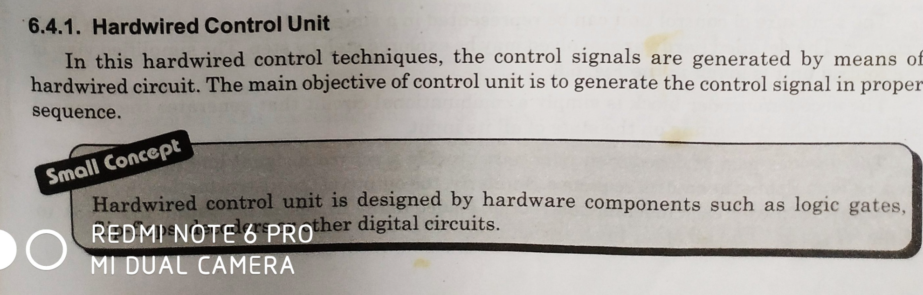
HARDWIRED CONTROL UNIT

Slide 4
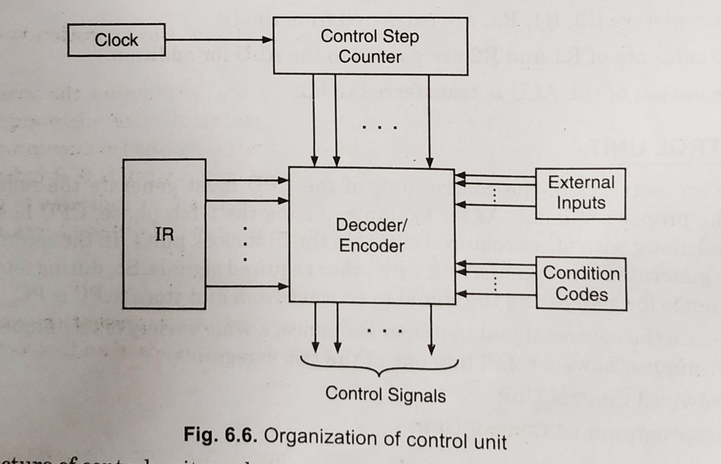
HARDWIRED CONTROL UNIT

Slide 5
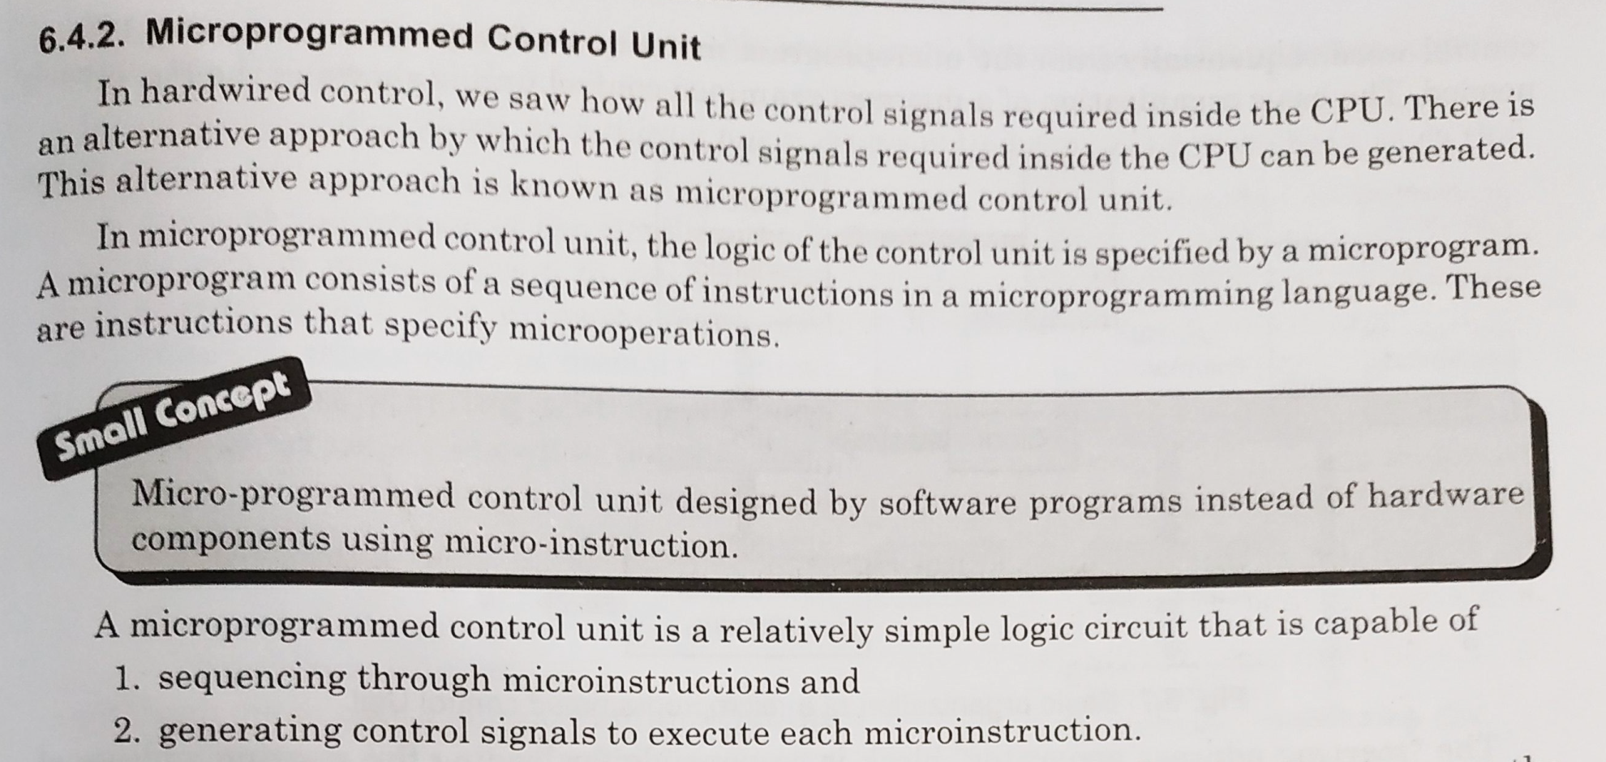
MICROPROGRAMMED CONTROL UNIT

Slide 6
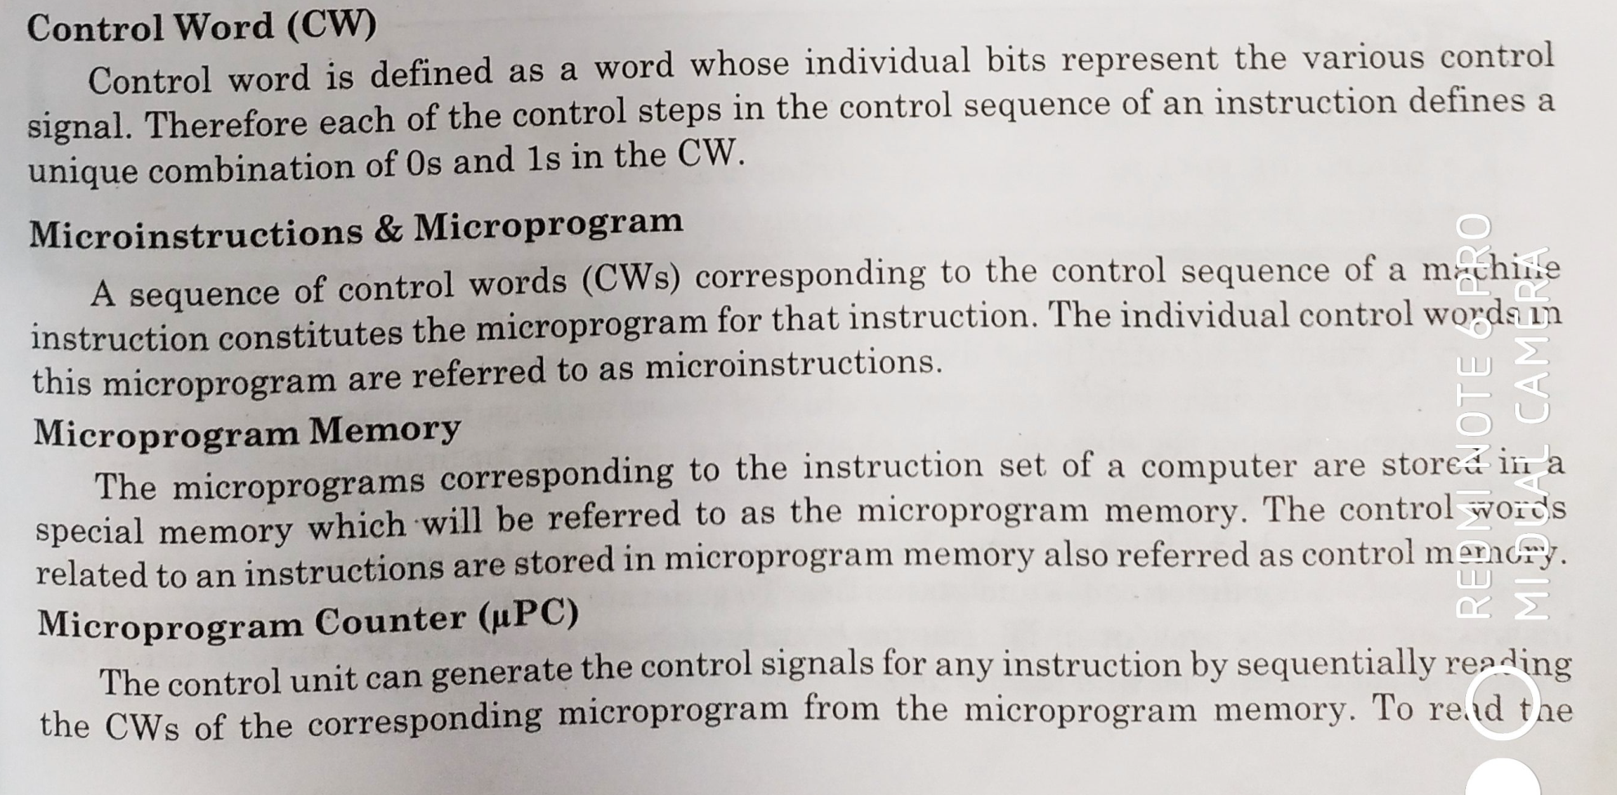
DIFFERENT TERMINALOGIES

Slide 7
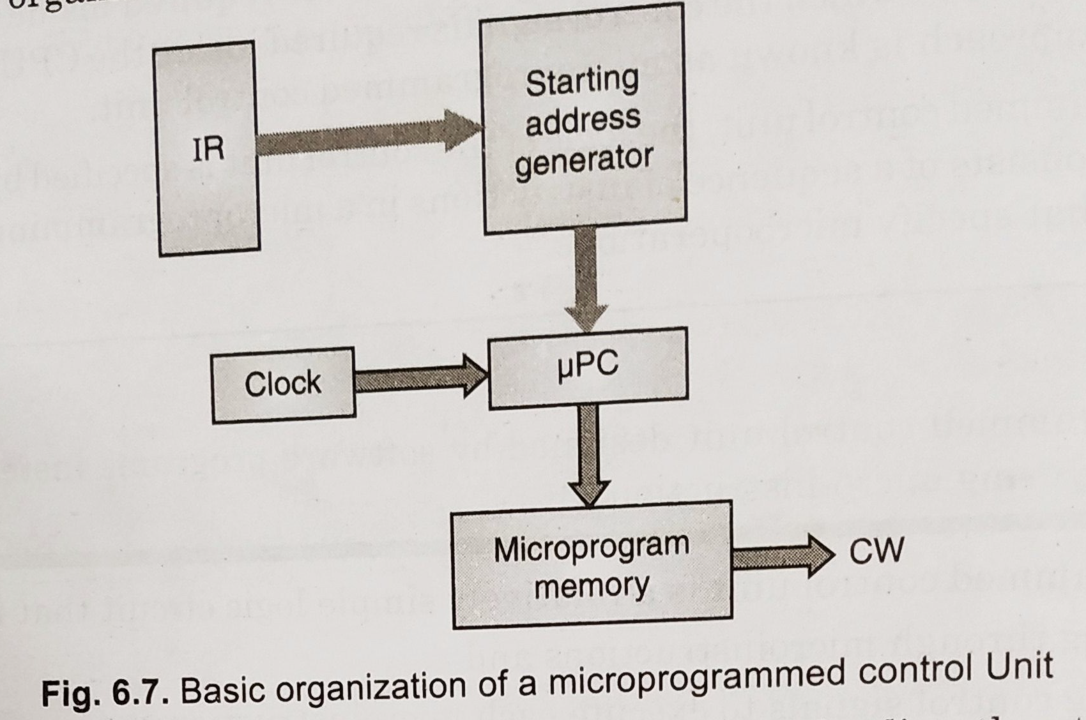
MICROPROGRAMMED CONTROL UNIT

Slide 8
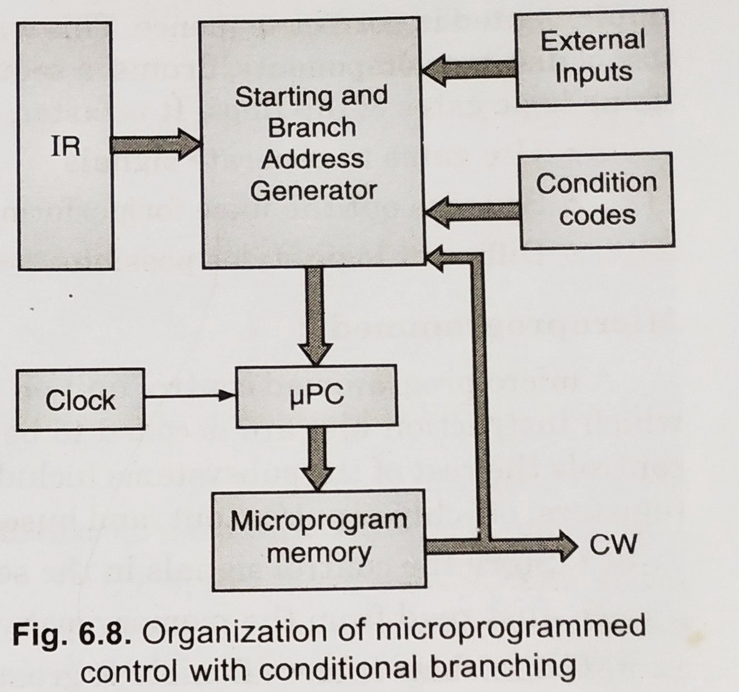
MICROPROGRAMMED CONTROL UNIT

Slide 9
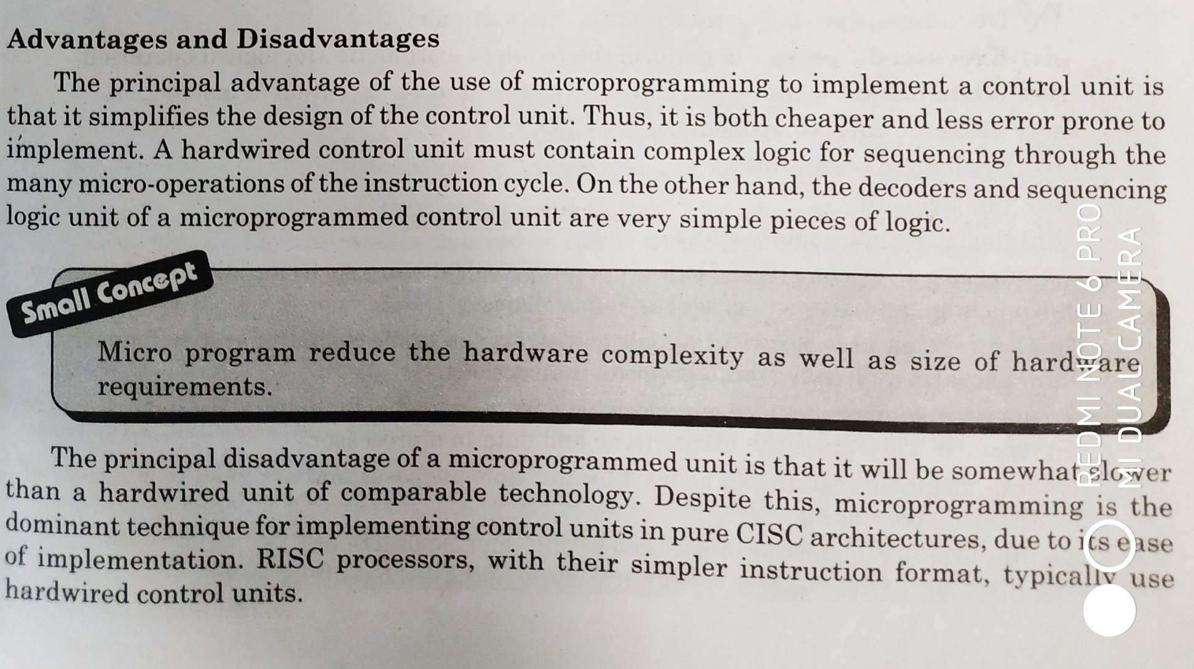
ADVANTAGES AND DISADVANTAGES

Slide 10
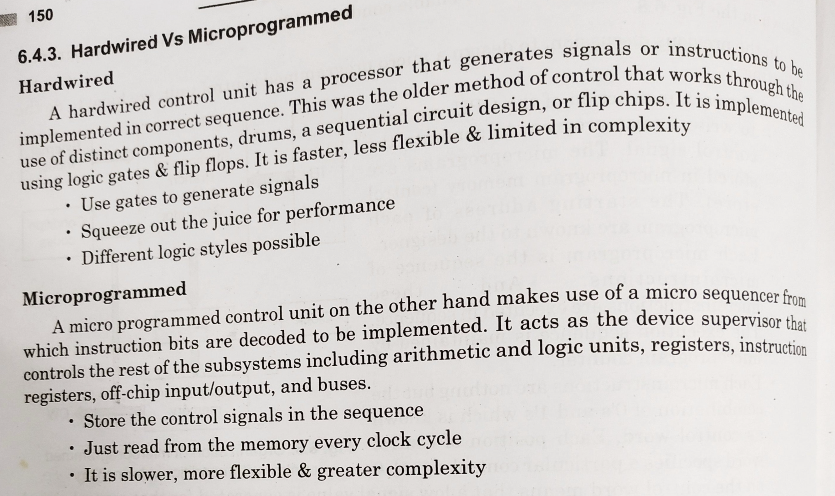
HIARDWIRED VS MICROPROGRAMMED

